Slide 1
Learning and Teaching Resources for Secondary History Curriculum Military History from Multiple Perspectives: Economy, Medicine, International Law and Others
For daily learning and teaching

Slide 2
Introduction
Published by the Personal, Social and Humanities Section of Curriculum Development Institute, Education Bureau (EDB)
Aim to support teachers in implementing the learning and teaching of the revised History Curriculum (S1-3)
Cater for students’ different learning needs and interests
Broaden students’ global perspectives
Help students understand that wars are man-made tragedies
Cultivate in students positive values and attitudes such as cherishing peace, upholding caring for others and perseverance.

Slide 3
For everyday learning and teaching
Historical knowledge
Historical skills
Positive values and attitudes

Slide 4
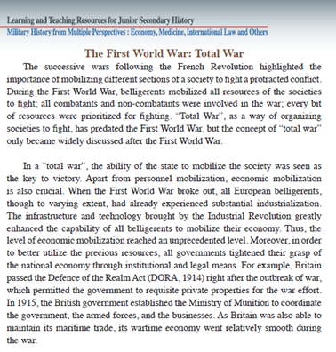
For everyday learning and teaching —Historical knowledge
Chapter 4: War and Society
In connection with Topic 9: International conflicts and crises in the 20th century (I) – the two world wars—Case study: Total war
Provide students with an in-depth and comprehensive knowledge about the concept of “total war”
Comprehend historical concepts and terms
Widen students’ historical and global perspectives
Chapter 1: War and Economy
Example 1

Slide 5
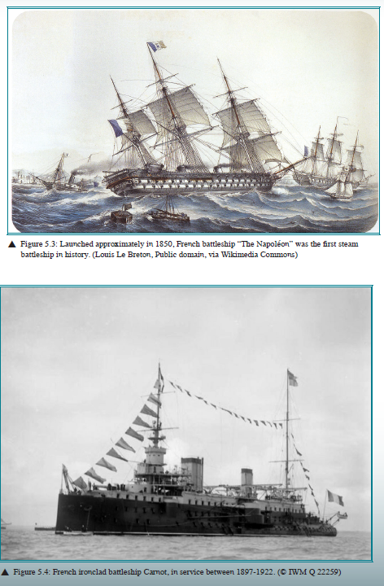
For everyday learning and teaching —Historical knowledge
In connection with Topic 5: The rise of modern Europe
Provide students with an in-depth and comprehensive knowledge about the “Impact of the Industrial Revolution”
Comprehend historical concepts and terms
Widen students’ historical and global perspectives
Chapter 5: War and Technological Innovation
Example 2

Slide 6
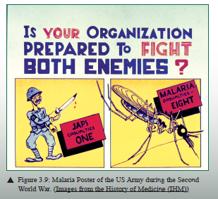
For everyday learning and teaching —Historical skills
Chapter 2: War and International Law
Make use of different primary and secondary sources in the resources to nurture historical skills such as:
Describe characteristics of pictures and cartoons
Comprehend the implication of sources
Select, organise and deploy sources, and express in a well-structured way
Example 3
Chapter 3: War and Medicine

Slide 7
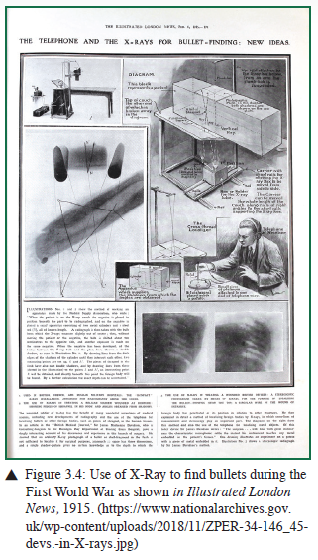
For everyday learning and teaching —Historical skills
Make use of different primary and secondary sources in the resources to nurture historical skills such as:
Describe characteristics of maps and diagrams
Comprehend the implication of sources
Select, organise and deploy sources, and express in a well-structured way
Chapter 3: War and Medicine
Chapter 1: War and Economy
Example 4

Slide 8
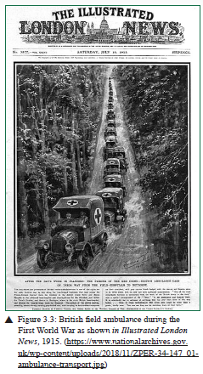
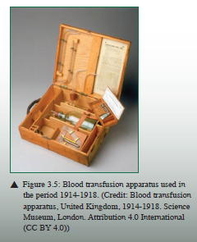
For everyday learning and teaching —Positive values and attitudes
Chapter 3: War and Medicine
Relate the study of history to contemporary life
Appreciate human achievements and aspirations
Example 5

Slide 9
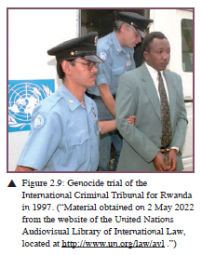
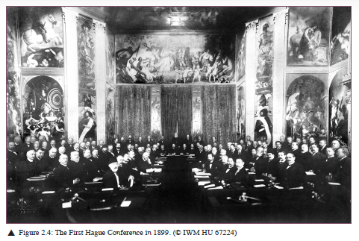
For everyday learning and teaching —Positive values and attitudes
Understand that wars are man-made tragedies
Cultivate in students positive values and attitudes of cherishing peace
Chapter 2: War and International Law
Example 6

